Slide 1
Introduction to Quantitative Financial Risk Management with R
Ted Kwartler
https://github.com/kwartler/Quantitative_Financial_Risk_Management_with_R

Slide 2










About me
Education
https://www.linkedin.com/in/edwardkwartler/
Work
Side Hustles

Slide 3
Agenda
Topic I
Obtaining Stock Data & Basic Visualization What is the financial market? Types of investing strategies. What is an API? API access to stock data in R Manipulate a time series object 1_TTR.R
3

Slide 4
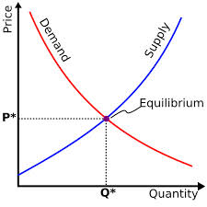
What is a Market?
Traditional Markets
Stock Markets
Bond Markets
Housing/Mortgages
Commodities – gold/silver etc
Crop Futures – corn/soybean
Consumer Credit
…
A market is one of the many varieties of systems, institutions, procedures, social relations and infrastructures whereby parties engage in exchange. Traditional markets are often regulated, have defined trading norms/rules, and have been in existence for some time.
4

Slide 5

Securities Trading can be distilled into 4 categories
Belief Based Investing
The intrinsic value of a company is appealing regardless of market & financial factors. As a result, intrinsic value changes trigger buy/sell action.
I like Wonder bread, so I bought stock in Flower Foods (FLO) since they make it.
https://www.steadygo.digital/blog/terrible-stock-photos/
5
Notes:
I like Netflix movies so I bought Netflix.
I don’t agree with tobacco sales so I avoid those stocks.
Warren Buffet “Buy companies you understand”

Slide 6

Securities Trading can be distilled into 4 categories
Financial Fundamentals Investing
Traditional financial performance indicators trigger an action regardless of sector, or company product.
Monsanto (MON) makes genetically modified food, I don’t care if they are safe. I bought the stock because the EPS is good.
6
Notes:
Reviewing an annual report and pouring over cash flow, revenue growth, expenditures like R/D all count as fundamental investing

Slide 7

Securities Trading can be distilled into 4 categories
Technical Trading
Trade based on “indications”. Uses non-financial mathematical indicators to quantify risk/reward, or trigger buy/sell
“Algorithmic Trading” – using algorithms to identify an equity action
Momentum – Recognize prices moving up/down at thresholds to trigger action
“Charting” – Visual chart patterns trigger actions (crossovers, head & shoulders)
The MACD crossover pattern for Smith & Wesson (AOBC) is positive so now is a good time to buy.
7
Notes:
Reviewing an annual report and pouring over cash flow, revenue growth, expenditures like R/D all count as fundamental investing

Slide 8
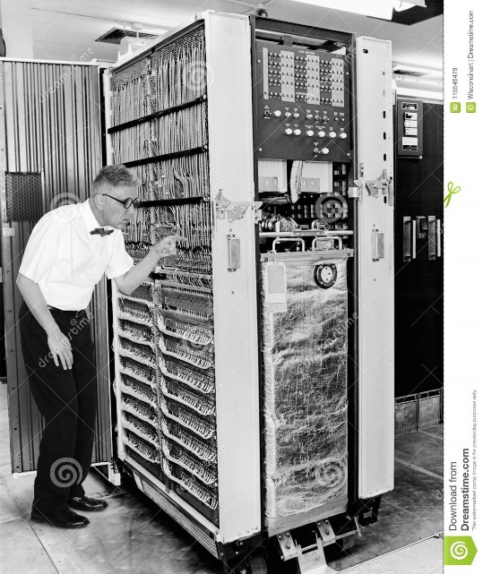

Securities Trading can be distilled into 4 categories
High Frequency Trading
Extremely technical trading executed without a human that can trigger thousands of actions measured in nano-seconds. “scalping” small profits thousands of times per minute.
1001100100…
*Although HFT uses algorithms:
>There is no human in the loop
>Primary profits derive from market making
8
Notes:
$460M

Slide 9

Speaking of Knight Cap
What happened to them?
Notes:
$460M

Slide 10
Keep in mind for trading…
In the short term the market is a NEGATIVE sum transaction. Market “makers” make money on the transactions. Retail investors pay a commission/fee for the trade.
Be careful & be sure to test your methods!
Notes:
$460M

Slide 11
What type?
The Stochastic Momentum Indicator (SMI), a formula for measuring momentum, crossed over to positive territory. I think I will buy Google (Alphabet).
Belief Based – some intrinsic value of the company is appealing and triggers a buy/selling action.
Fundamental Trading - traditional financial indicator triggers an action regardless of sector, or company product.
Technical Trading – trade based on “indications” or “algo trading”
High Frequency Trading – “scalping” small profits repeatedly
11

Slide 12
What type?
Our PhD physicist wrote an algorithm that trades apple stock 10,000 per minute.
Belief Based – some intrinsic value of the company is appealing and triggers a buy/selling action.
Fundamental Trading - traditional financial indicator triggers an action regardless of sector, or company product.
Technical Trading – trade based on “indications” or “algo trading”
High Frequency Trading – “scalping” small profits repeatedly
12

Slide 13
What type?
I won’t buy firearm companies.
Belief Based – some intrinsic value of the company is appealing and triggers a buy/selling action.
Fundamental Trading - traditional financial indicator triggers an action regardless of sector, or company product.
Technical Trading – trade based on “indications” or “algo trading”
High Frequency Trading – “scalping” small profits repeatedly
13

Slide 14
What type?
In our workshop we modeled the probability of risk using a decision tree and it looks like buying a consumer loan is a good investment.
Belief Based – some intrinsic value of the company is appealing and triggers a buy/selling action.
Fundamental Trading - traditional financial indicator triggers an action regardless of sector, or company product.
Technical Trading – trade based on “indications” or “algo trading”
High Frequency Trading – “scalping” small profits repeatedly
14

Slide 15
What type?
Google’s quarterly ad revenue is improving, so I am going to buy some shares.
Belief Based – some intrinsic value of the company is appealing and triggers a buy/selling action.
Fundamental Trading - traditional financial indicator triggers an action regardless of sector, or company product.
Technical Trading – trade based on “indications” or “algo trading”
High Frequency Trading – “scalping” small profits repeatedly
15

Slide 16
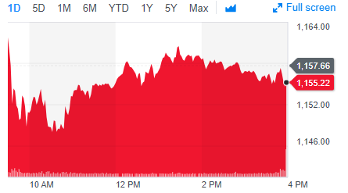
Stock Prices represent a time series
PRICE or Volume
TIME
Stock price of US Steel
16

Slide 17
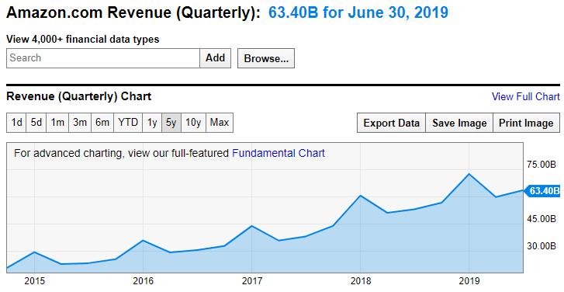
Not all times series can be forecasted
Qrtly Revenue
TIME
https://ycharts.com/companies/AMZN/revenues
This time series has a trend and seasonality so a traditional forecasting method like Holt Winters could be used.
17

Slide 18
Stock Prices represent a time series
Random Walk
VS.
Predictable Patterns (non-stock)
From a forecasting perspective stock prices are often considered a “random walk” meaning traditional econometric forecasting techniques do not apply.
18

Slide 19
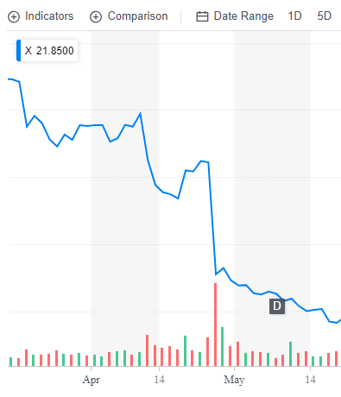
Why can’t you forecast the time series?
Daily Chart
U.S. Steel
4/25/17 Close : $31
4/26/17 Close: $22
4/26/17 Volume spike
19

Slide 20
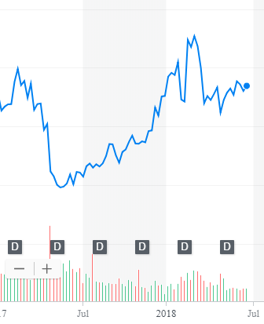
What other forces can impact US Steel?
Weekly Chart
U.S. Steel
4/25/17 Close : $31
4/26/17 Close: $22
4/26/17 Volume spike
5/15/17: ~$20
2/26/18: ~$45
Missed Qrtly Earnings
20

Slide 21
What other forces can impact US Steel?
Weekly Chart
U.S. Steel
4/25/17 Close : $31
4/26/17 Close: $22
4/26/17 Volume spike
5/15/17: ~$20
2/26/18: ~$45
4/16/18: ~$36
6/16/18: ~36
Missed Qrtly Earnings
Steel tariffs
21

Slide 22
What other forces can impact US Steel?
Weekly Chart
U.S. Steel
4/25/17 Close : $31
4/26/17 Close: $22
4/26/17 Volume spike
5/15/17: ~ $20
2/26/18: ~ $45
4/16/18: ~ $36
6/16/18: ~ $36
Missed Qrtly Earnings
Steel tariffs
Retaliatory Auto tariffs
22

Slide 23
So forecasting (pattern recognition) methods won’t work.
Weekly Chart
U.S. Steel
Some stock movements are self-inflicted (quarterly miss), others political (tariffs) while others are based on out of sector (automotive) performance.
External factors remove pattern recognition that econometric forecasts seek.
23

Slide 24
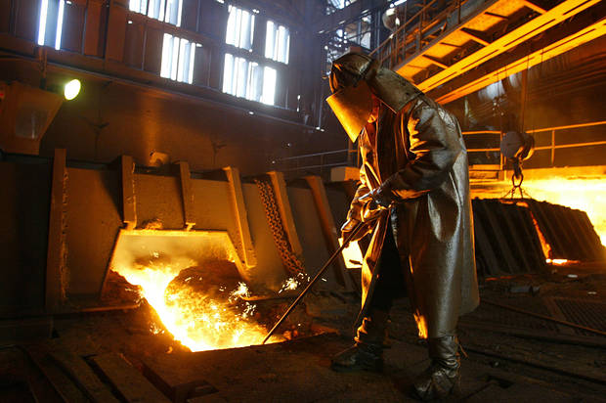
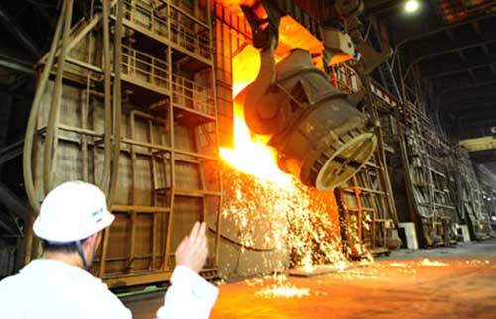

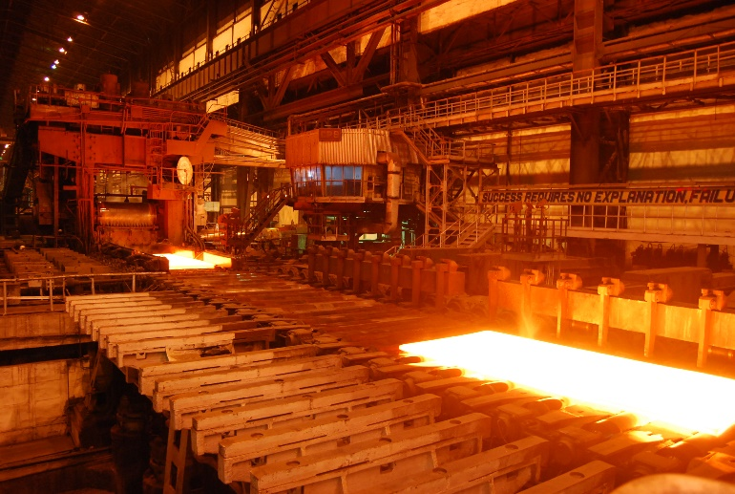
Meanwhile, US Steel was... producing steel.
A belief investor would not have bought or sold.
24

Slide 25
Meanwhile, US Steel was... producing steel.
A fundamental investor would have sold after the quarterly earnings report waiting for another financial indicator to buy again (next quarter).
25

Slide 26
Meanwhile, US Steel was... producing steel.
A technical investor may have gotten out after the price drop but back in as positive moment based on steel tariffs occurred only to sell again after the momentum faded based on automotive tariffs
26

Slide 27
Meanwhile, US Steel was... producing steel.
An HFT would have been in and out many times per second and minute making money no matter the direction, they work only with speed as an advantage.
27

Slide 28
Agenda
Topic I
Obtaining Stock Data & Basic Visualization What is the financial market? Types of investing strategies. What is an API? API access to stock data in R Manipulate a time series object 1_TTR.R
28

Slide 29

What is an API?
“Application Program Interface”
Clearly defined methods of communication between various software components.

Slide 30
Two Popular Response Formats
XML – Extensible Markup Language
Ever wonder why Excel files went from xls to xlsx? The data is stored as XML.
JSON- Javascript Object Notation
Lightweight text files used in webpage visualizations and to pass information.
Ask a question
Respond in XML or JSON

Slide 31


An example, your phone’s mapping function
“Your phone requests information from the maps API services to render the information.

Slide 32
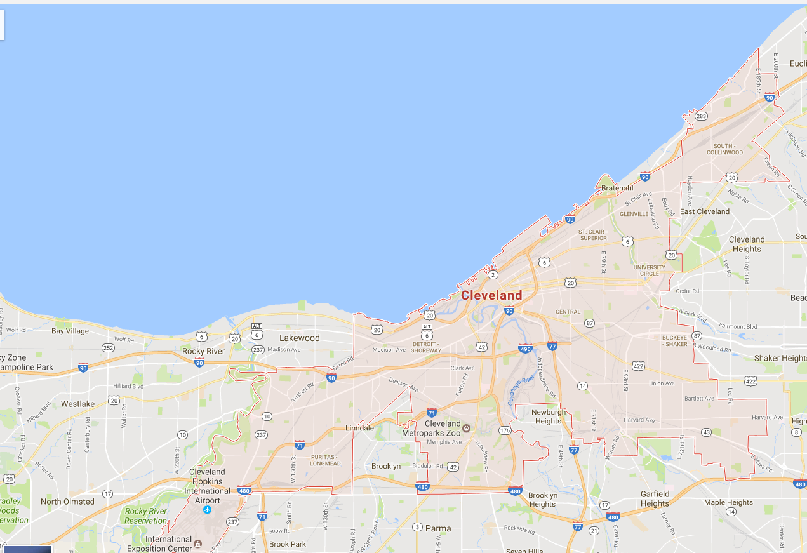
Cleveland Ohio USA Map

Slide 33
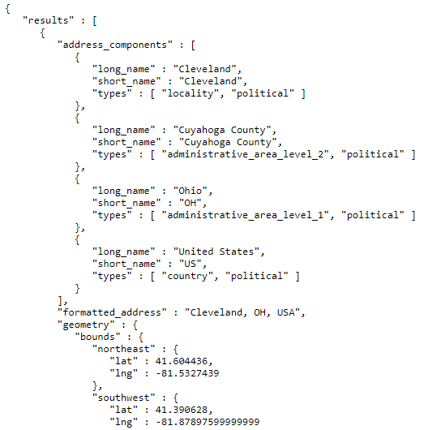
Google Maps API JSON
Cleveland name
More location information
Some coordinates of the shaded bounding box
Your phone parses JSON and renders the information on top of the map tile (shaded bounding box).

Slide 34


R has many API related libraries.
Quantmod handles the request & organizing data to a time series object.
Rather than code requests & parse responses ourselves we use the quantmod package.

Slide 35
Agenda
Topic I
Obtaining Stock Data & Basic Visualization What is the financial market? Types of investing strategies. What is an API? API access to stock data in R Manipulate a time series object 1_TTR.R
35

Slide 36
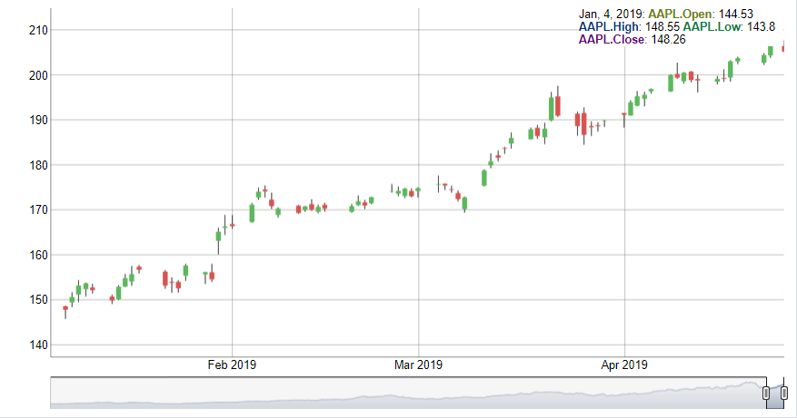
Interpreting a Candlestick Chart
Down Day
Up Day
High Price
High Price
Opening Price
Closing Price
Closing Price
Opening Price
Low Price
Low Price

Slide 37
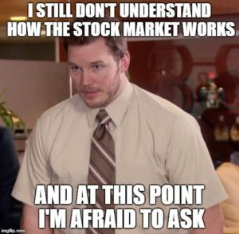
Let’s Practice! Open 1_TTR_A.R
Learning Objective:
Get real stock data
Subset an xts object
Plot the time series dynamically
37

Slide 38
Agenda
Topic II
Creating the first indicator Explain what a technical trading rule/indicator is Learn what a lagged simple moving is Calculate & Visualize 3 SMAs to understand the “smoothing” effect on time series data 1_TTR_B.R
38

Slide 39
Technical traders use “indicators” to trigger actions.
Define an indicator related to a stock.
Back-test the indicator to see how it operates in various market conditions. Once acceptable returns are proven move to step 3.
Monitor a stock’s indicator inputs i.e. closing price but could also be twitter mentions etc.
When the indicator is triggered an action “buy, hold, sell, short” is executed.
Continue to monitor the indicator inputs to re-evaluate the action

Slide 40
Technical traders use “indicators” to trigger actions.
1. Indicator:
If the daily Boris Johnson quotes of “Brexit” is greater than 5, then buy (or hold) WLTW (Willis Towers Watson) the next day.
2. Back-testing:
In the last 180 days, this indicator has yielded a 6% return [fictitious]
3. In Production:
Set up a script to monitor Boris’ Brexit quotes and buy if the number is greater than 5.
4. Execution:
In any given day that has quotes > 5 buy WLTW otherwise have no position.
5. Continual Monitor:
If you are in WLTW and quotes is < 5, then sell and vice versa.

Slide 41
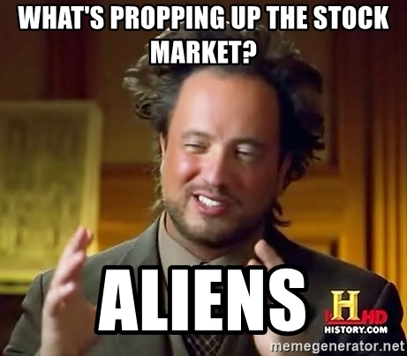
Technical Trading Assumptions
“what” > “why”
Price action > reasons for move (non-explanatory)
Technical traders don’t necessarily care why a price changes.
41

Slide 42
Technical Trading Assumptions
“what” > “why”
Price action > reasons for move (non-explanatory)
Known information is already reflected in the price.
Technical traders believe tradeable information is immediately embedded in the price (not worth the effort to “scalp” or trade based on speed).
42

Slide 43
Technical Trading Assumptions
“what” > “why”
Price action > reasons for move (non-explanatory)
Known information is already reflected in the price.
Buyers & sellers trade based on emotion.
Fear & greed are powerful forces
Technical traders realize that some amount of trades occur due to emotion. Technical traders are unemotional when trading thereby exploiting the emotional traders.
43

Slide 44
Technical Trading Assumptions
“what” > “why”
Price action > reasons for move (non-explanatory)
Known information is already reflected in the price.
Buyers & sellers trade based on emotion.
Fear & greed are powerful forces
Markets fluctuate.
For technical traders to be successful, there needs to be pricing volatility.
44

Slide 45
Let’s zoom into Technical Trading Rules (TTR)
Our learning goal is to use and understand some of the common technical indicators which affect you as a saver, pension holder, stock trader etc.
Further research is needed to be successful.
Our learning goal is NOT to make you a trader, or convince you that you are now qualified to be a technical trader.
45

Slide 46
Agenda
Topic II
Creating the first indicator Explain what a technical trading rule/indicator is Learn what a lagged simple moving is Calculate & Visualize 3 SMAs to understand the “smoothing” effect on time series data 1_TTR_B.R
46

Slide 47
In addition to quantmod we will use TTR (technical trading rules)
library(TTR)
SMA() #simple moving average
MACD() #moving avg convergence/divergence
RSI() #Relative Strength Index
For expediency we will cover simple indicators but there are many more and you could even develop your own.

Slide 48
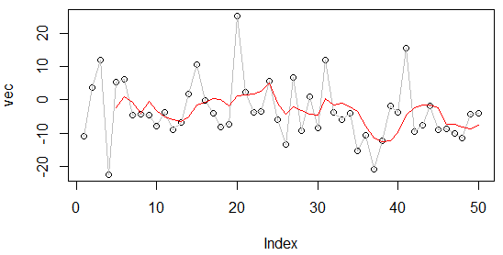
What is a moving average?
set.seed(1234)
vec <-rnorm(50,1,10)
plot(vec)
lines(vec, col='grey')
lines(SMA(vec, n=5), col='red')
A smoothing technique reducing noise in a data series. Takes the average over “n” number of periods.
48

Slide 49
What is a moving average?
set.seed(1234)
vec <-rnorm(50,1,10)
plot(vec)
lines(vec, col='grey')
lines(SMA(vec, n=5), col='red')
vec[1:15]
[1,] -11.070657
[2,] 3.774292
[3,] 11.844412
[4,] -22.456977
[5,] 5.291247
[6,] 6.060559
[7,] -4.747400
[8,] -4.466319
[9,] -4.644520
[10,] -7.900378
[11,] -3.771927
[12,] -8.983864
[13,] -6.762539
[14,] 1.644588
[15,] 10.594941
A smoothing technique reducing noise in a data series. Takes the average over “n” number of periods.
49

Slide 50
What is a moving average?
vec[1:15]
[1,] -11.070657
[2,] 3.774292
[3,] 11.844412
[4,] -22.456977
[5,] 5.291247
[6,] 6.060559
[7,] -4.747400
[8,] -4.466319
[9,] -4.644520
[10,] -7.900378
[11,] -3.771927
[12,] -8.983864
[13,] -6.762539
[14,] 1.644588
[15,] 10.594941
A smoothing technique reducing noise in a data series. Takes the average over “n” number of periods.
50

Slide 51
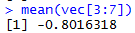
What is a moving average?
vec[1:15]
[1,] -11.070657
[2,] 3.774292
[3,] 11.844412
[4,] -22.456977
[5,] 5.291247
[6,] 6.060559
[7,] -4.747400
[8,] -4.466319
[9,] -4.644520
[10,] -7.900378
[11,] -3.771927
[12,] -8.983864
[13,] -6.762539
[14,] 1.644588
[15,] 10.594941
A smoothing technique reducing noise in a data series. Takes the average over “n” number of periods.
51

Slide 52
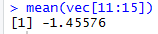
What is a moving average?
vec[1:15]
TTR::SMA(vec[1:15], n=5)
[1,] -11.070657
[2,] 3.774292
[3,] 11.844412
[4,] -22.456977
[5,] 5.291247
[6,] 6.060559
[7,] -4.747400
[8,] -4.466319
[9,] -4.644520
[10,] -7.900378
[11,] -3.771927
[12,] -8.983864
[13,] -6.762539
[14,] 1.644588
[15,] 10.594941
[1,] NA
[2,] NA
[3,] NA
[4,] NA
[5,] -2.5235367
[6,] 0.9027066
[7,] -0.8016318
[8,] -4.0637779
[9,] -0.5012865
[10,] -3.1396115
[11,] -5.1061087
[12,] -5.9534017
[13,] -6.4126457
[14,] -5.1548241
[15,] -1.4557603
A smoothing technique reducing noise in a data series. Takes the average over “n” number of periods.
52

Slide 53
What is a moving average?
A smoothing technique reducing noise in a data series. Takes the average over “n” number of periods.
vec[1:15]
TTR::SMA(vec[1:15], n=5)
[1,] -11.070657
[2,] 3.774292
[3,] 11.844412
[4,] -22.456977
[5,] 5.291247
[6,] 6.060559
[7,] -4.747400
[8,] -4.466319
[9,] -4.644520
[10,] -7.900378
[11,] -3.771927
[12,] -8.983864
[13,] -6.762539
[14,] 1.644588
[15,] 10.594941
[1,] NA
[2,] NA
[3,] NA
[4,] NA
[5,] -2.5235367
[6,] 0.9027066
[7,] -0.8016318
[8,] -4.0637779
[9,] -0.5012865
[10,] -3.1396115
[11,] -5.1061087
[12,] -5.9534017
[13,] -6.4126457
[14,] -5.1548241
[15,] -1.4557603
53

Slide 54

So how does SMA become an Indicator?
Red Card! We need to lag the trading rule to ensure the signal is realistic. Calculations are not real time, but at the day’s close so you need to adjust the results to emulate a real scenario.
54

Slide 55
This is a “centered” moving average
vec[1:15]
[1,] -11.070657
[2,] 3.774292
[3,] 11.844412
[4,] -22.456977
[5,] 5.291247
[6,] 6.060559
[7,] -4.747400
[8,] -4.466319
[9,] -4.644520
[10,] -7.900378
[11,] -3.771927
[12,] -8.983864
[13,] -6.762539
[14,] 1.644588
[15,] 10.594941
A centered moving average uses information from the future (days ahead) which is unrealistic.

Slide 56
The data must be lagged so the value is known during trading time.
vec[1:15]
[1,] -11.070657
[2,] 3.774292
[3,] 11.844412
[4,] -22.456977
[5,] 5.291247
[6,] 6.060559
[7,] -4.747400
[8,] -4.466319
[9,] -4.644520
[10,] -7.900378
[11,] -3.771927
[12,] -8.983864
[13,] -6.762539
[14,] 1.644588
[15,] 10.594941
Lagged 2 days but can be any appropriate “n”
The calculation is lagged so the information is presented on a day you could actually make a trading decision.

Slide 57
Agenda
Topic II
Creating the first indicator Explain what a technical trading rule/indicator is Learn what a lagged simple moving is Calculate & Visualize 3 SMAs to understand the “smoothing” effect on time series data 1_TTR_B.R
57

Slide 58
Open 1_TTR_B.R
Learning Objective:
Get real stock data
Subset an xts object
Create three simple moving averages and plot to see the smoothing effect
58

Slide 59
Agenda
Topic III
Applying the SMA Indicator 50 & 200 day as a trading indicator Calculate the investment return with SMAs “death” and “golden” cross pattern Explain what a back-test is for evaluating an indicator Visualize the historical performance using a back-test 3_TTR.R Q&A Break (5 minutes)
59

Slide 60
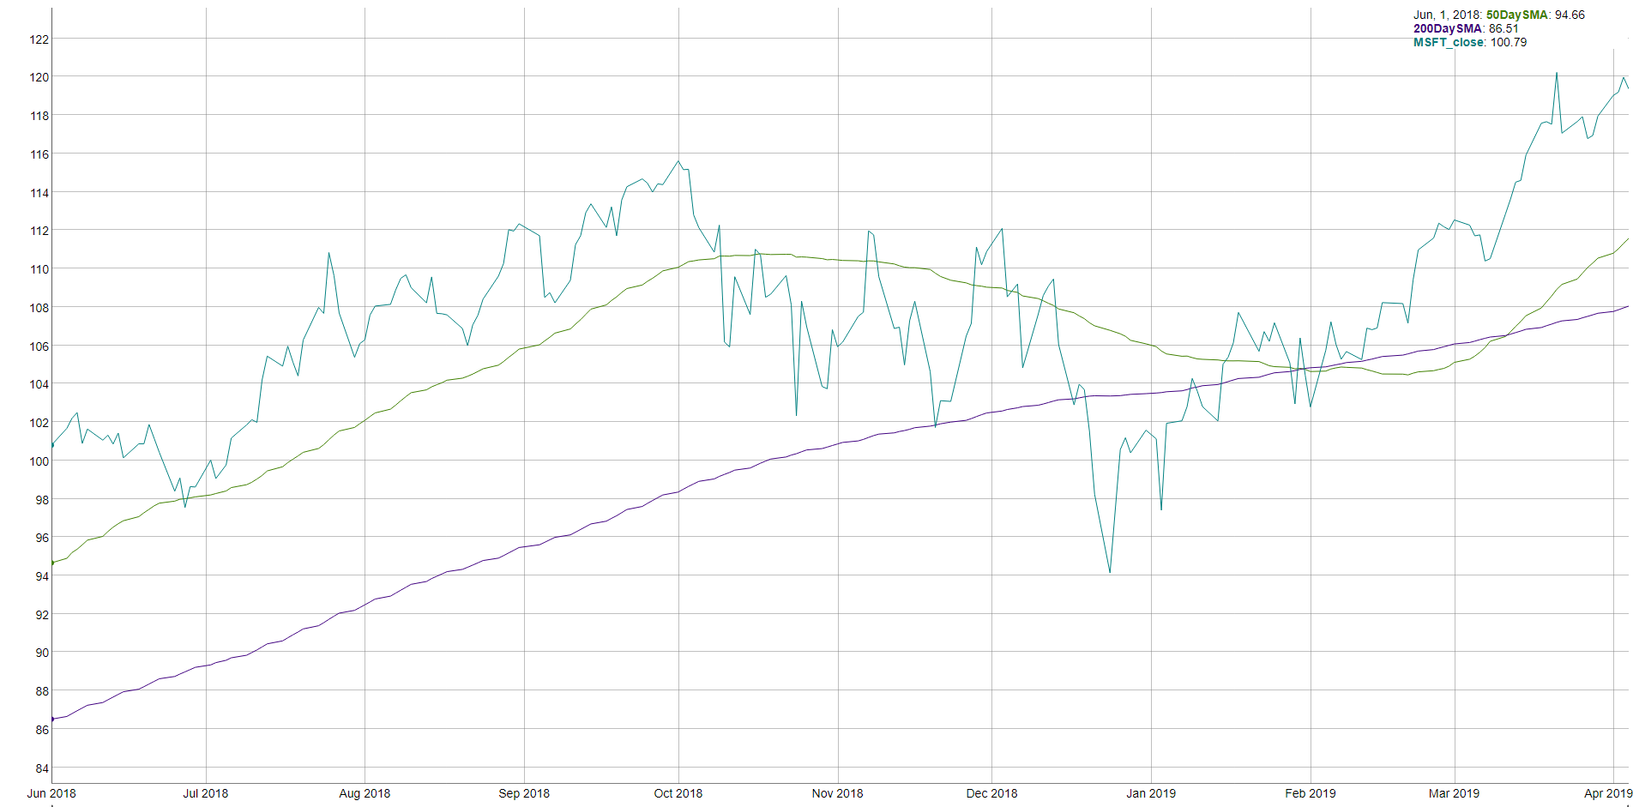
How does SMA become an indicator? MSFT 50 & 200 day SMA
“Golden Cross”
“Death Cross”

Slide 61
How does SMA become an indicator? MSFT 50 & 200 day SMA
“Golden Cross”
“Death Cross”
200 day: 9.5 months of trading
50 day: ~2.4 months of trading
Indicator Information
If the 50day average is > than the 200day then money is moving into the stock. Converse is True.

Slide 62
Agenda
Topic III
Applying the SMA Indicator 50 & 200 day as a trading indicator Calculate the investment return with SMAs “death” and “golden” cross pattern Explain what a back-test is for evaluating an indicator Visualize the historical performance using a back-test 3_TTR.R Q&A Break (5 minutes)
62

Slide 63
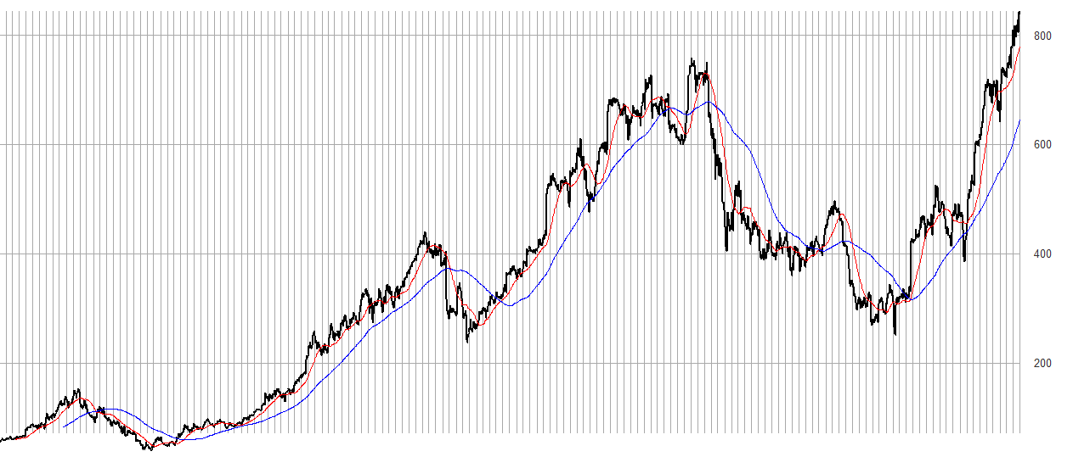
Once you have an indicator you must test it.
An investor can “backtest” the strategy to find an acceptable “n” in case 50/200 doesn’t work. Once the best “n” is found, an investor can look for “crosses” to indicate buy/sell.

Slide 64
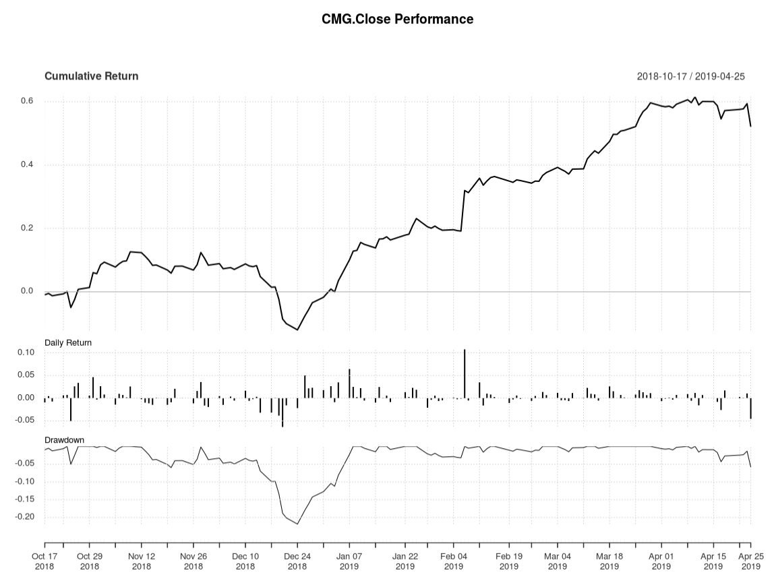
Interpreting the Rate of Change (ROC)
Total Cumulative Return using the rule.
Day to Day Return
Important if rule is sub one day periodicity.
Peak to trough % change, used to understand volatility.
SMA as an Indicator for CMG as shown in a performance chart.
64
Notes:
Peak to trough analysis is a measure of volatility and often used in intraday. A good resource is http://www.pring.com/articles/article7.htm

Slide 65
Agenda
Topic III
Applying the SMA Indicator 50 & 200 day as a trading indicator Calculate the investment return with SMAs “death” and “golden” cross pattern Explain what a back-test is for evaluating an indicator Visualize the historical performance using a back-test 3_TTR.R Q&A Break (5 minutes)
65

Slide 66

Open 1_TTR_C_50Day_200Day_SMA.R
Learning Objective:
Get real stock data
Subset an xts object
Calculate SMA 50 & 200
Create a trading indicator (rule)
Lag the Rule
Back-test the lagged rule to see cumulative returns
Switch a single character in the rule & back-test again to see the impact like Knight Capital
66

Slide 67
Agenda
Topic III
Applying the SMA Indicator 50 & 200 day as a trading indicator Calculate the investment return with SMAs “death” and “golden” cross pattern Explain what a back-test is for evaluating an indicator Visualize the historical performance using a back-test 3_TTR.R Q&A Break (5 minutes)
67

Slide 68
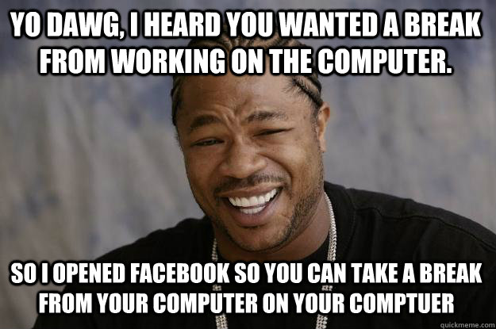
Break!

Slide 69
Agenda
Topic IV
Creating the MACD Indicator Walk through the moving avg convergence divergence indicator Manually calculate a standard moving average Apply the MACD signal as an indicator Visualize the stock & MACD in a dynamic plot 1_TTR_D.R Debrief on MACD visuals & back-test Q&A
69

Slide 70
Moving Average Convergence Divergence
By measuring the moving average of two moving averages with different time frames, an investor hopes to capture when momentum is building or receding.

Slide 71

Moving Average Convergence Divergence
Money is moving into a stock…let’s jump on the upswing!
Money is moving away from a stock…let’s sell!

Slide 72
Moving Average Convergence Divergence
Instead of SMA’s “n”:
nFast(12) – the smaller window to measure (12 periods)
nSlow(26)- the longer window to measure (26 periods)
nSig(9)- the number of periods used to measure the avg difference “signal”
72

Slide 73
Moving Average Convergence Divergence
Instead of SMA’s “n”:
nFast(12) – the smaller window to measure (12 periods)
nSlow(26)- the longer window to measure (26 periods)
nSig(9)- the number of periods used to measure the avg difference “signal”
Calculate the 12 (nFast) day & 26 (nSlow) day moving averages.
Calculate the difference between averages from #1
Calculate the 9 day Moving Avg (nSig) of #2
73

Slide 74
Moving Average Convergence Divergence
Instead of SMA’s “n”:
nFast(12) – the smaller window to measure (12 periods)
nSlow(26)- the longer window to measure (26 periods)
nSig(9)- the number of periods used to measure the avg difference “signal”
Calculate the 12 (nFast) day & 26 (nSlow) day moving averages.
Calculate the difference between averages from #1
Calculate the 9 day Moving Avg (nSig) of #2
When MACD > Signal, the price is accelerating, positive momentum/money is coming to the equity which represents a buying opportunity. Converse is true.
74

Slide 75
One small addition difference.
SMA
EMA
Each value in the “n” window has an different weight. The weights decrease the farther back in time e.g. recent data is more relevant.
Each value in the “n” window has an equal weight.
Usually the MACD uses the Exponential Moving Average (EMA) not Simple Moving Average
75
Notes:
Advantage:
Faster to recognize a buy/sell signal.
Disadvantage:
More false signals, more sensitivity

Slide 76
SMA Vs EMA
vec <- c( 1.2, 0.2, 10, 20.3, 104.3)
Each value has equal weight in the window.
Recent values have MORE weight in the window.
TTR::SMA(vec, n=3)
TTR::EMA(vec, n=3)
= 44.86
= 58.175

Slide 77
Agenda
Topic IV
Creating the MACD Indicator Walk through the moving avg convergence divergence indicator Manually calculate a standard moving average Apply the MACD signal as an indicator Visualize the stock & MACD in a dynamic plot 1_TTR_D.R Debrief on MACD visuals & back-test Q&A
77

Slide 78
Open 1_TTR_D.R
Learning Objective:
Get real stock data
Subset an xts object
Calculate MACD
Plot a dynamic graph of the closing & MACD indicator
Visually inspect the results of buy/sell actions
Calculate cumulative return for the indicator
78

Slide 79
Agenda
Topic IV
Creating the MACD Indicator Walk through the moving avg convergence divergence indicator Manually calculate a standard moving average Apply the MACD signal as an indicator Visualize the stock & MACD in a dynamic plot 1_TTR_D.R Debrief on MACD visuals & back-test Q&A
79

Slide 80
As a momentum indicator…
MACD captures when the market is moving positively or negatively towards an equity. When emotional sentiment is positive or negative.
MACD does not “Buy Low & Sell High” It’s buy high and sell higher!
MACD will not identify the market low point or high point exactly. So the returns will never be 100% of the possibility.

Slide 81
Agenda
Topic V
Creating & Applying the RSI Indicator Learn what a relative strength indicator is Interpret RSI as an indication Construction & visualization of RSI in dynamic plot with 1_TTR_F.R
81

Slide 82
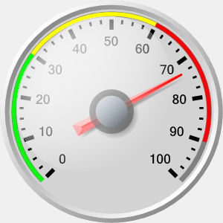
Relative Strength Index (RSI)
Momentum Oscillator
Index between 0-100
Compares average gains and losses in 14 day periods (“n”)
Usually interpreted as an overbought/oversold (over 70 / below 30)
* Usually uses EMA but we will do SMA.
82

Slide 83
Creates a control chart.
overbought
70
Sell
RSI
Hold
30
Buy
oversold
TIME
When the RSI dips below a threshold (30) the stock is considered “oversold” meaning the market has overreacted indicating a buying opportunity. RSI greater than 70 indicates the market is over buying the stock so it may be good to exit your position.
83

Slide 84
First the Relative Strength
RS = Avg Gain / Avg Loss
Avg Gain = For “up” days, total number of points up / number of “up” days (14 trading days)
Avg Loss = For “down” days, total number of points down/ number of “down” days (14 trading days)
84

Slide 85
Calculating the RSI
RSI = 100 - (100 / 1+RS)
Where RS:
RS = Avg Gain / Avg Loss
Avg Gain = For “up” days, total number of points up / number of “up” days (14 trading days)
Avg Loss = For “down” days, total number of points down/ number of “down” days (14 trading days)
85

Slide 86
Open 1_TTR_F.R PART ONE
Learning Objective:
Get real stock data
Calculate RSI
Plot a dynamic graph of the closing & RSI indicator
Visually inspect the results of buy/sell actions
86

Slide 87
Agenda
Topic V
Compounding Two or More Indicators Visualize a stock’s RSI & MACD in a dynamic plot 1_TTR_F.R Combine two indicators as one for back-testing Q&A Break (5min)
87

Slide 88

Break!

Slide 89
Agenda
Topic VI
Predicting Loan Defaults Lending Club Information Fit a model to the loan data & save as an example Fit a more validated model with new loans Visualize the loans in a dynamic plot Q & A
89

Slide 90

Consumer Credit - Lending Club
Consumers apply for loans & instead of bank funding, other consumers fund the loan by purchasing “notes” to receive the interest.
Peer to Peer funding for
Personal Loans
Auto Loans
Small Business Loans
Medical Loans
Everyday investors can accept the loan risk – making it a new banking distribution model
Consumer credit is a traditional market. There are defined inputs (credit score), consumer protections (usury laws), and established distribution (credit applications).
90

Slide 91
What’s the Risk?
Risk
Mitigation
Over exposure in a single loan
Diversify – Do not fund more than $25 on a single loan
Early payment reduces interest received
Monitor & re-invest monthly
Illiquid – notes are 36-60 months
Buy notes with 36m horizons
Default – debtors that stop paying
Model the probability of default
91

Slide 92
What’s the Reward?
Reward
Result
Interest is imposed by LC
Investors have no input to the amount
Usually lower rates for the applicant
Lower capital cost for debtor
LC takes 1% of interest
Reduces reward incentive for investor
Remaining interest is paid monthly to note holders.
Investors act as banks & receive consistent returns
92

Slide 93

Example
Erin decides to buy a car. Instead of a traditional loan she applies at LC.
Erin applies for a $10k car loan
LC assesses her creditworthiness & posts a $10k loan @ 6% interest on the investor site.
Trish & hundreds of other LC investors fund the loan in $25 increments called “notes”
Each month Erin pays her loan, LC takes 1% and the investors make 5% on their outstanding notes.
93

Slide 94
Example
11 yrs of historical performance – Over 1M notes publicly available
Some platform changes in that time
Datasets are updated monthly
Sampled to 20k – either in fully paid of charged off state
Loan Origination
36 or 60 Monthly Payments
Fully Paid
1 = Success Class
Transitional States of Nature:
Grace Period, 30-60,60-90 days
0 = Failure Class
Charged Off
https://www.lendingclub.com/info/download-data.action
94

Slide 95
What is cross – validation?
This is a typical partitioning schema to avoid overfitting.
Training Data
All Data
Test Data
95
Notes:
No Cross Validation
No Feature Engineering

Slide 96
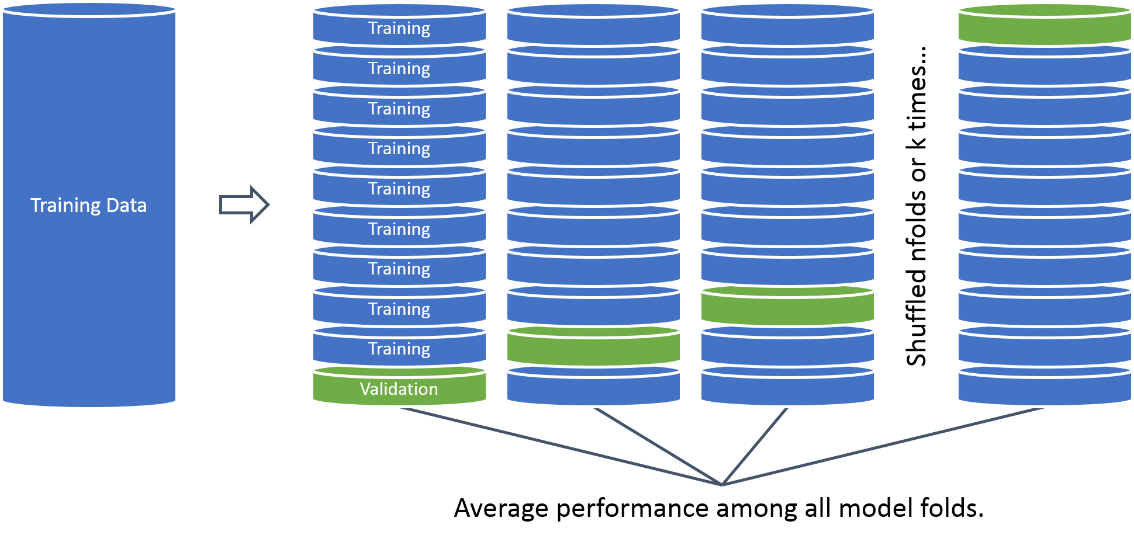
What is cross – validation?
In this example we will perform cross validation because the data set is only 20k records.
96

Slide 97
Open 2_ConsumerCreditTraining.R
Learning Objective:
Load in real lending club data
Treat the variables for modeling
Build a cross validated logistic regression with caret
Save model object & variable treatment plan
97

Slide 98
Agenda
Topic VI
Predicting Loan Defaults Lending Club Information Fit a model to the loan data & save as an example Fit a more validated model with new loans Visualize the loans in a dynamic plot Q & A
98

Slide 99
Cutoff Threshold
Is 0.50 the optimal cutoff?
Should we be equal weighted?
Do we care equally about picking paying notes and charged off loans?
99

Slide 100
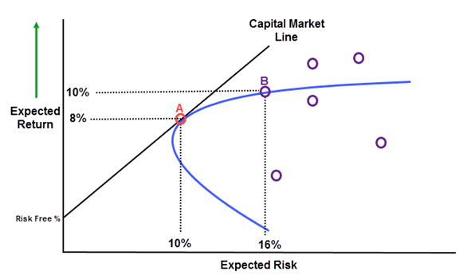
Making a CAPM style plot
100

Slide 101
Open 2_ConsumerCreditScoring.R
Learning Objective:
Score notes
Make a plot similar to CAPM & identify top loans to fund
101

Slide 102
Agenda
Topic VII
Simulating a Non-Traditional Mkt Opportunity Review the trading card market as an investment vehicle Structure problem for analysis Sample with probability & simulate mkt buying to quantify risk Q & A
102

Slide 103
Non-Traditional Markets
Traditional
Non-Traditional
Stock Markets
Bond Markets
Housing/Mortgages
Commodities – Gold, Silver etc.
Crop Futures
Consumer Credit
Crypto-currencies
Beanie Babies
Derivatives (originally)
Web Domains
…
In contrast to traditional markets, emerging or non traditional markets lack transparency, regulations and can often be manipulated more easily.
103

Slide 104
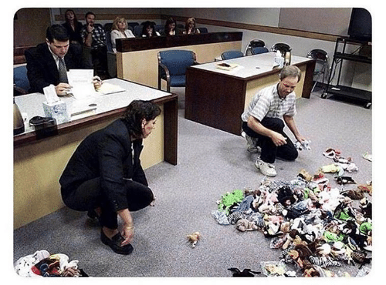
A Non-Traditional Mkt…
104

Slide 105


Another non-traditional Market Example
Owned by Hasbro, MTG is a 25 year old collectible trading card game. It is estimated that there are 8-12million players worldwide. Thus is it popular and has demonstrated longevity unlike other non-traditional markets.
105

Slide 106
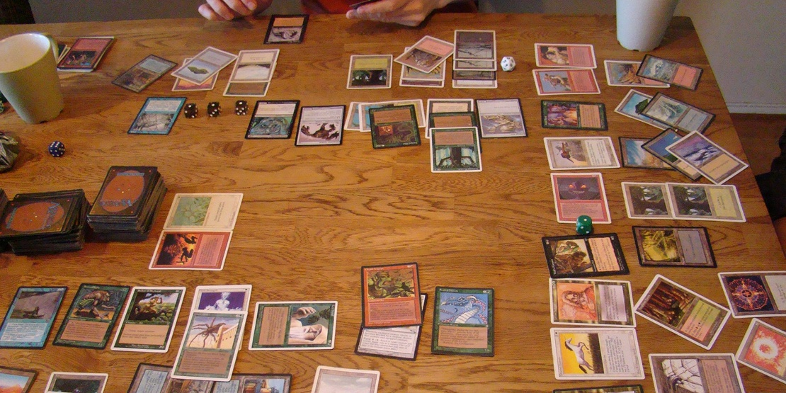
Magic The Gathering
Players create 60 card decks with cards of different abilities for a duel. Cards are fantasy based with creatures, sorceries, and mythical artifacts.
106

Slide 107
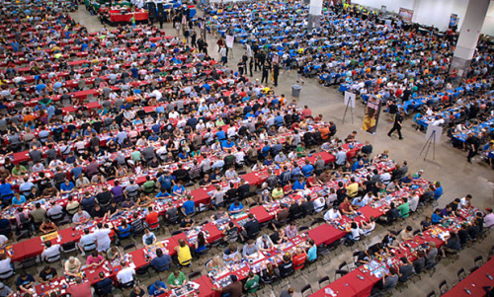

Magic The Gathering
The cards have limited print runs & varying rarities
107

Slide 108
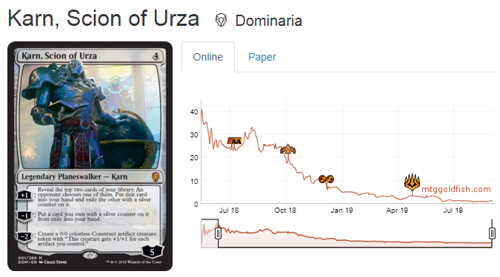
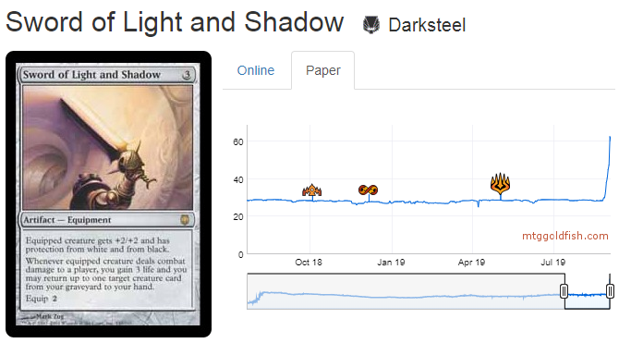
And that’s why it’s a market…
Some cards go up and others down at sites like mtggoldfish.com and mtgstocks.com
108

Slide 109
So how do you get cards?
For $19
You could buy Karn from an online marketplace.
For $3
You can open a booster pack from the appropriate expansion set and hope you get it.
For $90
You can buy a booster box of 36 packs from the set and increase your odds of getting it while also getting many other potential valuable cards.
For $540
You can buy 6 of the booster boxes in a case.
Say you are a player that needs to get Karn, Scion of Urza to complete a deck.
109

Slide 110
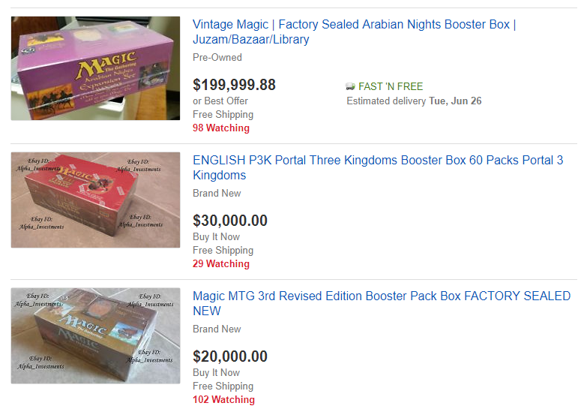
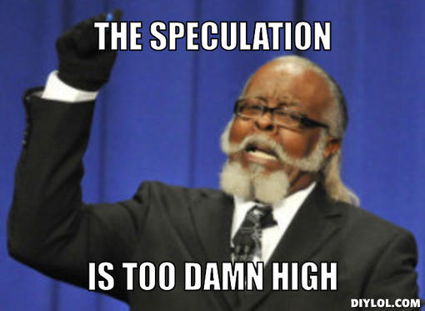
People Speculate as Supply Diminishes
110

Slide 111
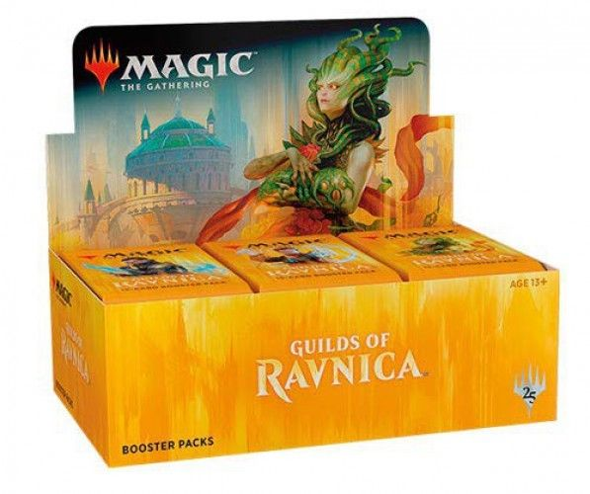
New set characteristics
Usually a pack contains
11 Commons
3 Uncommons
1 Rare
1 in 8 packs will replace the rare with a mythic
1 in 6 packs will have a random premium foil card replacing a common.
111

Slide 112
Modeling a new set according to risk & reward
When you open a pack:
Risk:
Each expansion set has varying prices. Some cards are worthless while other cards can be expensive..
Reward:
Some packs will contain expensive cards which you can immediately sell for more than the cost of the pack.
Since we know the cards in a set, their prices, and the probabilities of getting specific cards, we can simulate pack openings.
*Keep in mind there are friction costs, shipping a physical good takes time and money.
112

Slide 113
Agenda
Topic VII
Simulating a Non-Traditional Mkt Opportunity Review the trading card market as an investment vehicle Structure problem for analysis Sample with probability & simulate mkt buying to quantify risk Q & A
113

Slide 114

Open 3_A_NonTraditionalMkts.R
Learning Objective:
Simulate opening to analyze a non-traditional market
114

Slide 115




